Slide 1
CTI League
Disinformation
2020-05-23
Discussion: Covid19 Disinformation Outside the USA

Slide 2
Questions about non-USA Disinfo
What’s happening in misinfo targeted to Africa and the Middle East?
Russia using Nigeria and Ghanaians for scams
How can this inform our understanding of narratives?
Region by region: what are the main topics?
Translators and resources in other countries?
What are the most effective channels used for disinfo in various countries?
Are the same tool chains being used form multiple types of attacks?
Antivax- How has it spread? What are the flows? Regional variations?

Slide 3
Places to Look for non-USA Disinformation
Disinformation repositories
https://euvsdisinfo.eu/disinformation-cases/ - Russia disinfo on EU
https://medium.com/dfrlab - world disinfo
https://comprop.oii.ox.ac.uk/ - nationstate actors
Specifically The Global Disinformation Order and https://comprop.oii.ox.ac.uk/wp-content/uploads/sites/93/2019/09/Case-Studies-Collated-NOV-2019-1.pdf
https://www.newsguardtech.com/covid-19-resources/ - c19 domains for several countries
Hive cases, MISP events etc
E.g. reopen starting in Australia, moving to Canada etc

Slide 4
Things to think about: who
How is a country involved?
Disinformation customer / originator
Disinformation target
Disinformation producer / factory
What type of disinformation?
Geopolitics / nationstate propaganda: country A to country B/C/etc
Politics / propaganda: country A to own population
Grifting: individuals to population (usually for money)
Power: groups to population (recruiting, actions etc)

Slide 5
Things to think about: what
Localisation:
Local tech use (including social media)
Local power structures
Local concerns
Languages
Communication style
Local idioms (e.g. “cockroaches”)
Globalisation
Common themes: politics, grifters, 5g, antivax etc

Slide 6
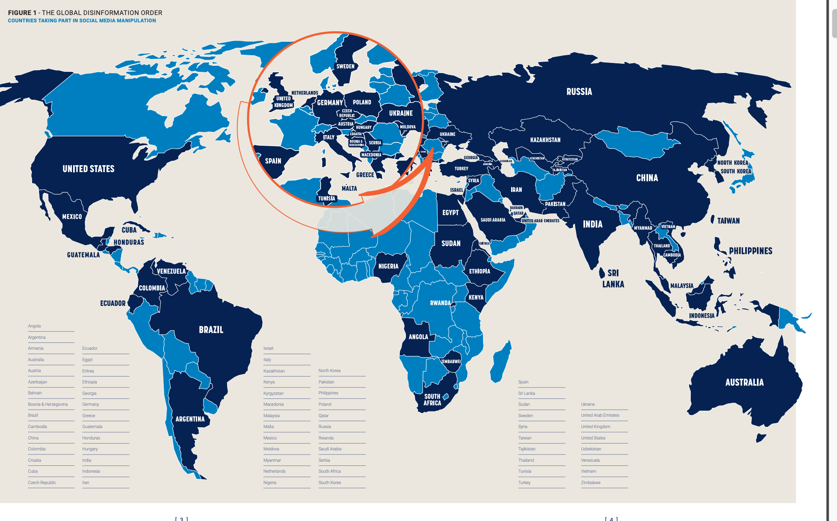
Comprop is a good place to start…
https://comprop.oii.ox.ac.uk/wp-content/uploads/sites/93/2019/09/CyberTroop-Report19.pdf

Slide 7
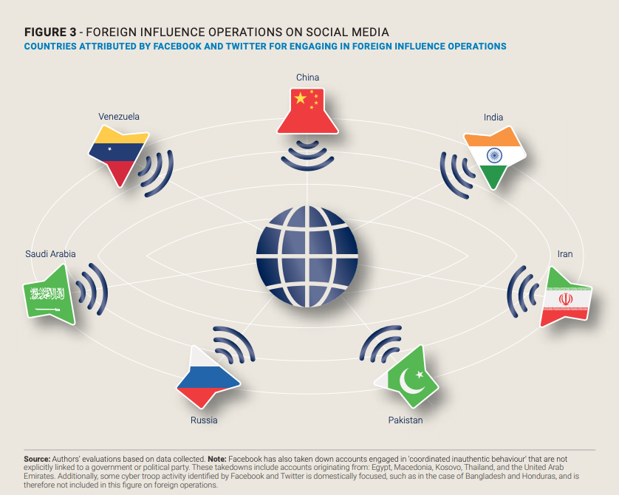
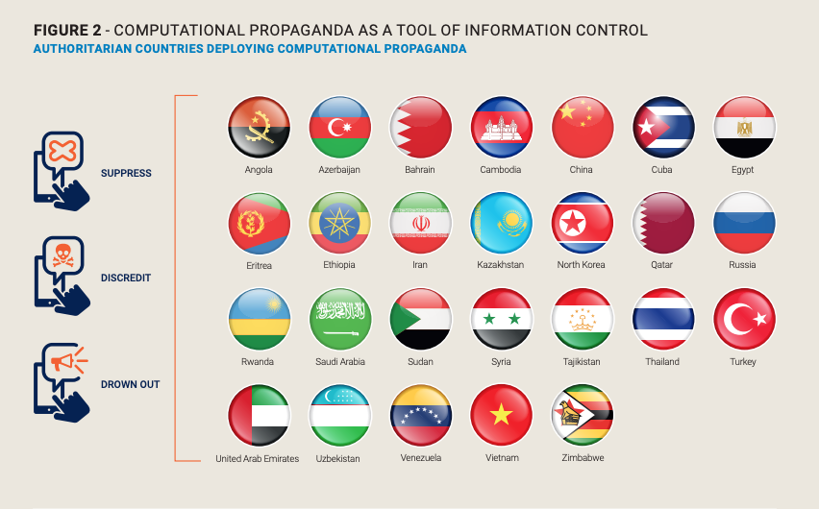
Comprop on Nationstate actors
External vs Internal disinformation

Slide 8
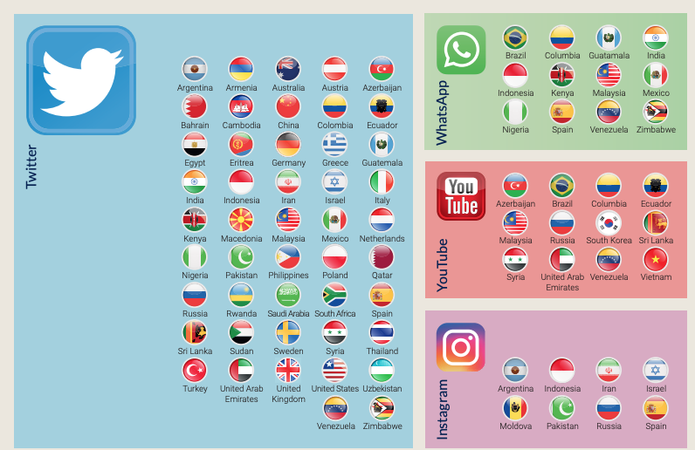
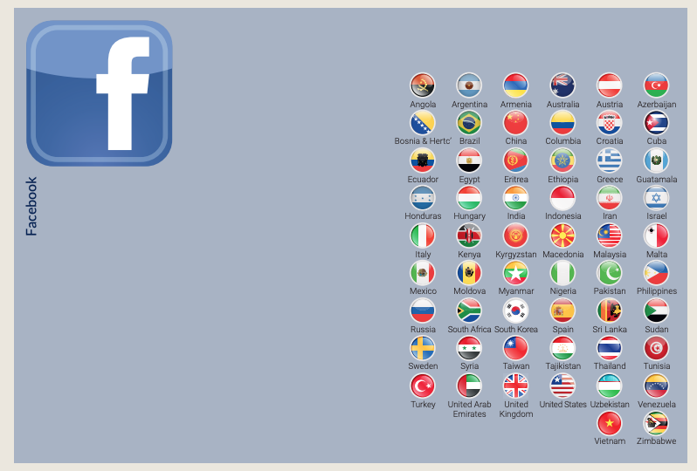
Comprop: Nationstate platform use
Facebook

Slide 9
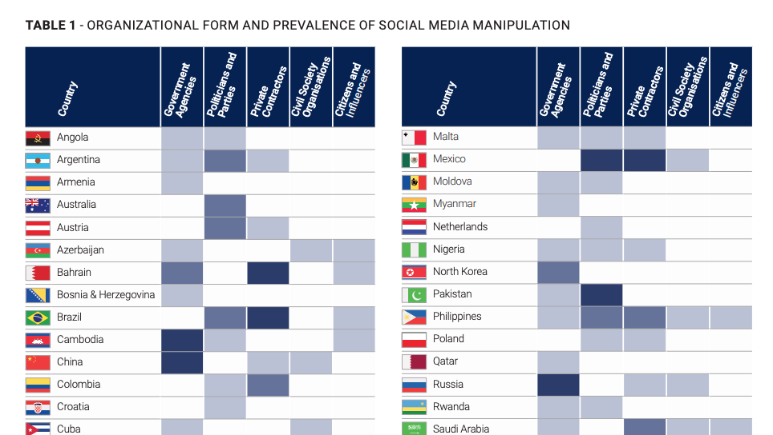
Comprop: Who

Slide 10
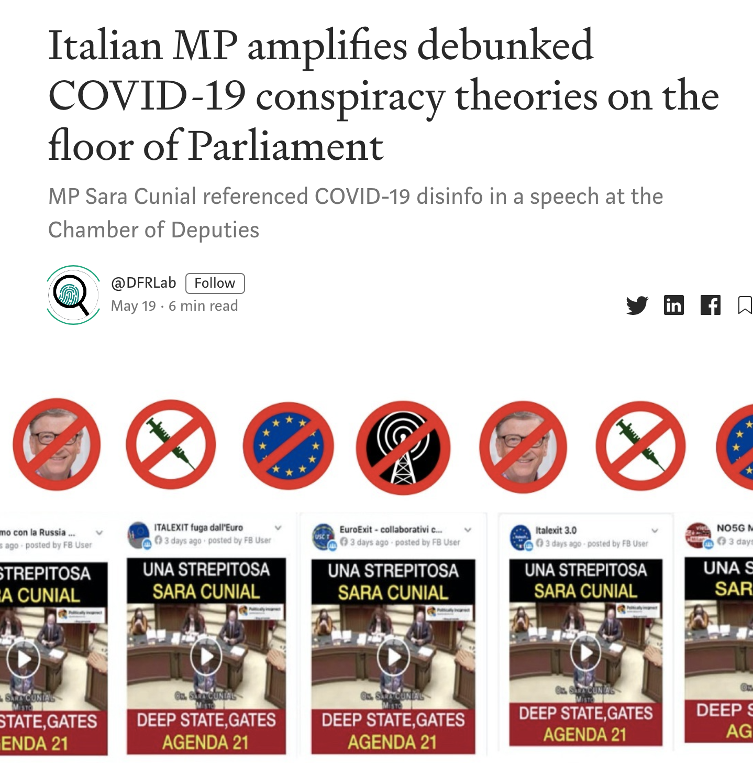
Italy - Early AntiVaxxers

Slide 11
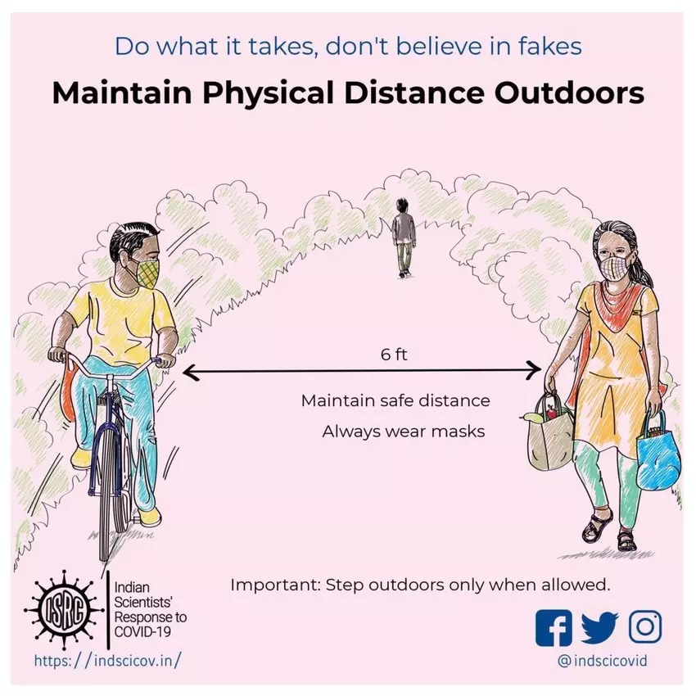
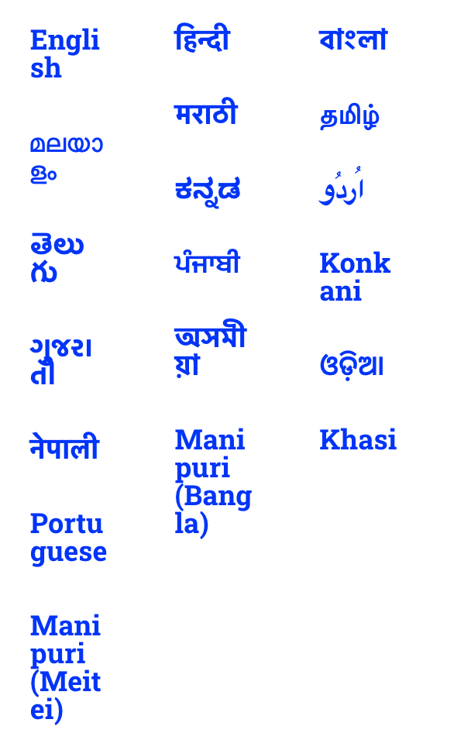
India - whatsapp, fake cures, SM responsible for curation, strong messaging from Modi

Slide 12
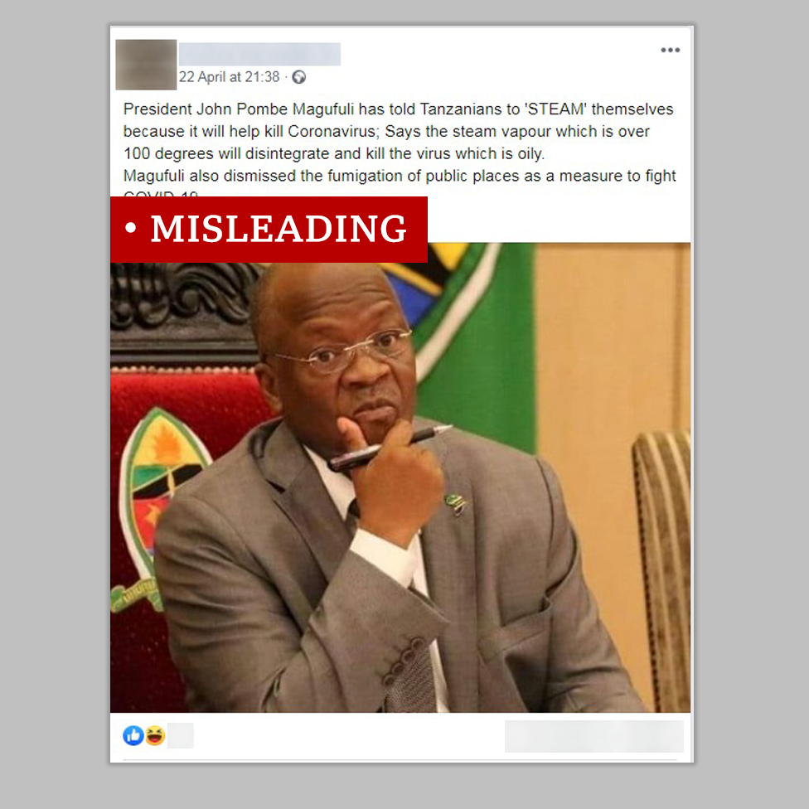
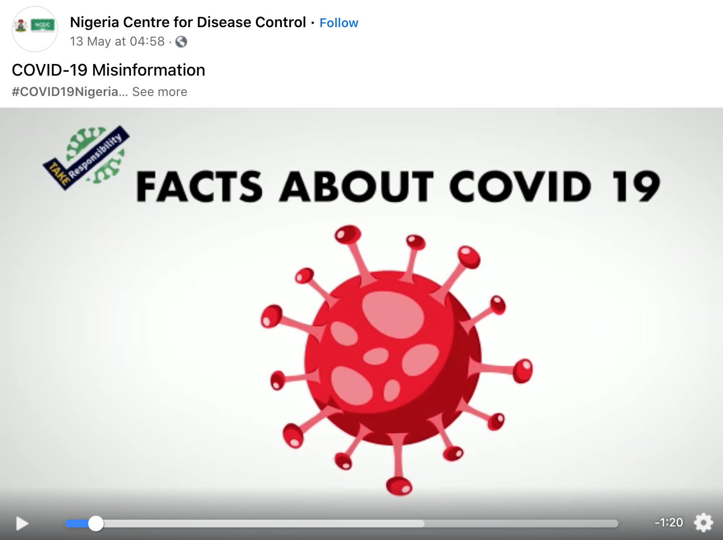
Africa: outbreaks, fake cures

Slide 13
Over to you…
… or we go to the Googles…

